Slide 1
Introduction to Game Development using Unity
By Evan Smith

Slide 2

Software Installation
Intro
If you haven’t installed the necessary software for Unity. DO IT NOW.
https://github.com/evanreidsmith7/UnityWorkshopTXSTIEEE --------------------->
I can only help Windows peeps with any issues sorry
I’d say my laptop specs are the minimum system requirements
I was able to run Unity okay on my laptop with 8GB DDR4 RAM but as my projects got bigger, I had to upgrade. Either way, if you want a smooth experience, don’t use a generic laptop like mine.
My Laptop Specs
CPU: Intel Core i5-1135G7, 8 threads - 2.4 GHz
GPU: Intel Iris Pro Graphics 6200, 128MB VRAM
RAM: 8GB DDR4 (now 20GB)

Slide 3

What is Unity?
Intro
Unity is a powerful, cross-platform game engine developed by Unity Technologies
Unity is popular for iOS and Android mobile game development, indie game development, and is considered easy to use for beginner developers
The engine provides an intuitive editor workspace, allowing developers to rapidly assemble scenes and create high-quality visuals
Unity also offers a scripting API using C# for programming game logic and interactions
Nearly half of the world's games are built with Unity

Slide 4
What else is Unity?
Intro
Unity is a game engine used for game development, but it is not limited to that.
It has been used to create high-fidelity CG films, such as through its pipeline options and animation tools.
Unity Reflect is a tool that provides building developers a way to visualize their projects and connect them with other CAD software.
Unity's technology is used by automakers to create full-scale models of new vehicles in virtual reality, build virtual assembly lines, and train workers
I learned and used Unity last summer for augmented reality research.
I developed an application for the Microsoft HoloLens 2.
My work is in the next slide

Slide 5
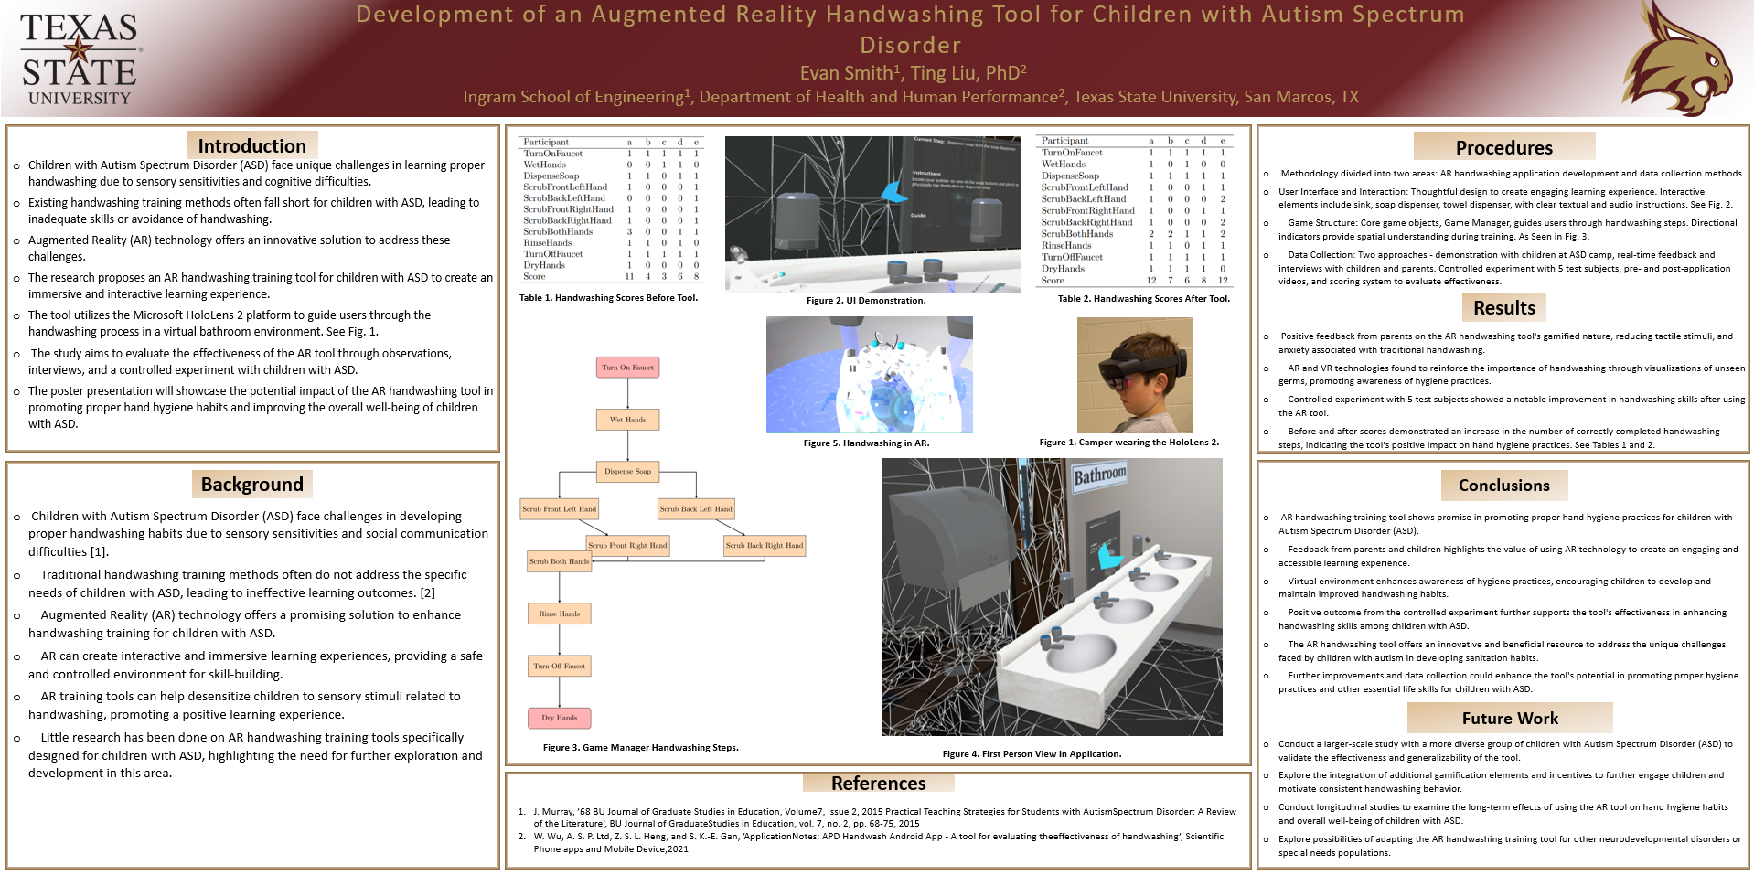
My Experience With Unity

Slide 6
Let’s learn the basics of unity
Tutorial
For those who are still installing, let me know when it’s done and I will push my repo, clone it to catch up.
I used the series Create with Code from Unity Learn to teach myself how to use Unity. I am going to attempt to condense one of the units for today’s workshop.
https://learn.unity.com/course/create-with-code
Specifically, we will learn player control. Maybe some game play mechanics if we have time.

Slide 7
COPY
Ref
If

Slide 8
Project Setup
Tutorial
Follow along in the README to setup first project.
https://github.com/evanreidsmith7/UnityWorkshopTXSTIEEE

Slide 9
Add a vehicle to the seen and get comfortable with (editor)UI
Tutorial
In the Project Window, open Assets > Course Library > Vehicles, then drag a vehicle into the Hierarchy
Hold right-click + WASD to fly to the vehicle, then try to rotate around it
With the vehicle selected and your mouse in the Scene view, Press F to focus on it
Use the scroll wheel to zoom in and out and hold the scroll wheel to pan
Hold alt+left-click to rotate around the focal point or hold alt+right-click to zoom in and out
If anything goes wrong, press Ctrl/Cmd+Z to Undo until it’s fixed

Slide 10
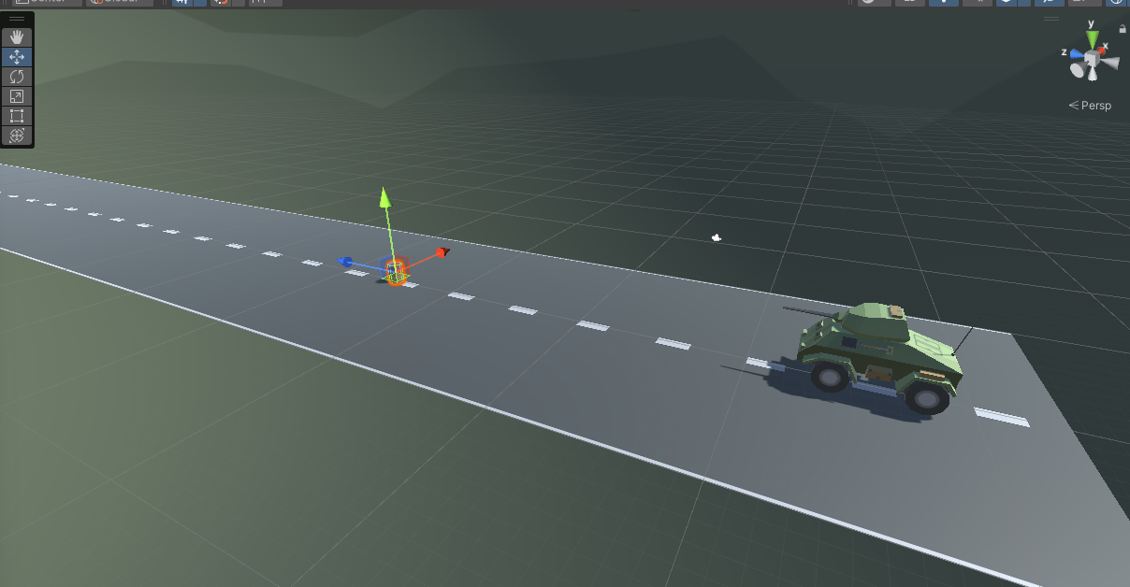
Add an obstacle and reposition it
Go to Course Library > Obstacles and drag an obstacle directly into the Scene view
In the Inspector for your obstacle, in the top-right of the Transform component, click the more options button > Reset Position Note: The more options button may appear as three vertical dots or a gear icon, depending on your version of Unity
In the Inspector, change the XYZ Location to x=0, y=0, z=25
In the Hierarchy, Right-click > Rename your two objects as “Vehicle” and “Obstacle”
You may also control transform by dragging the arrows on the selected object

Slide 11
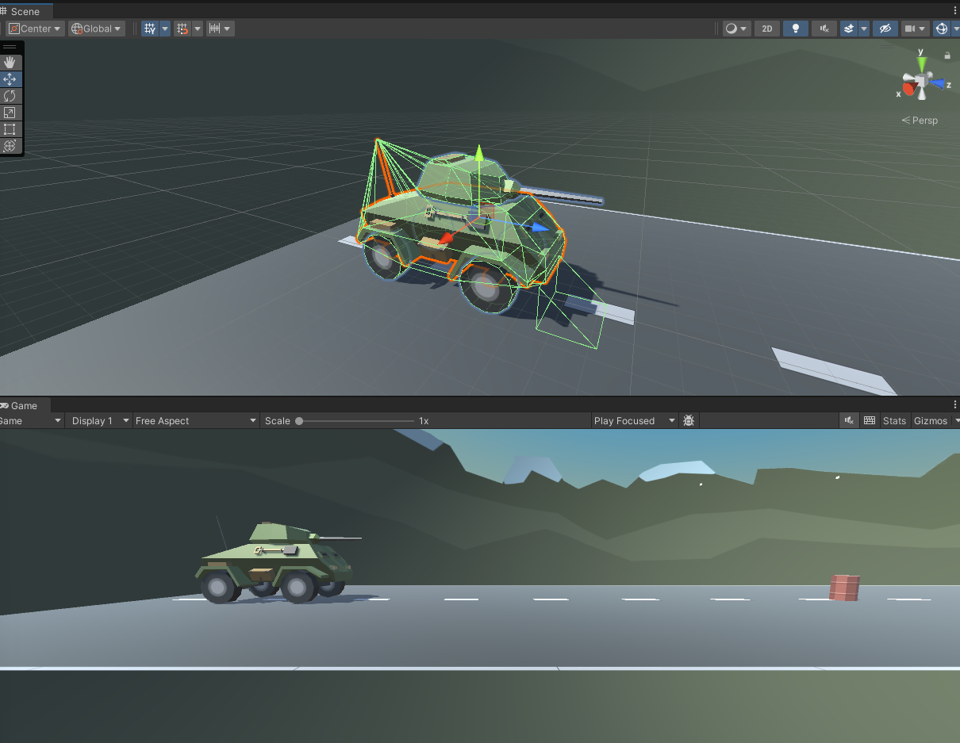
Camera
Select the Camera in the hierarchy, then press F to focus on it
Press the Play button to run your Game, then press Play again to stop it
Play Mode in Game View is where you “Run” your program. Whatever changes you make in play mode will not save. You can still move objects around to see how they interact during run time.
You will press this button a million times as you develop.

Slide 12
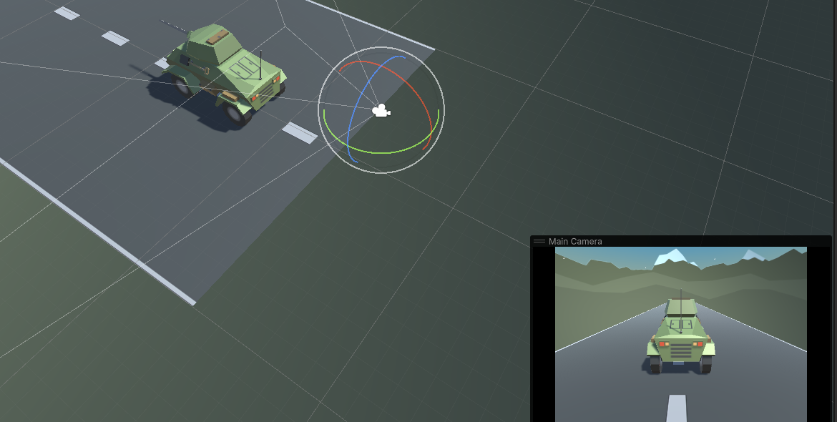
Reposition Camera behind Vehicle
Tutorial
Use the Move and Rotate tools to move the camera behind the vehicle looking down on it
Hold Ctrl/Cmd to move the camera by whole units
Play around as you move the camera with the axis in the top right
You the rotation tool to get a good view of the vehicle

Slide 13
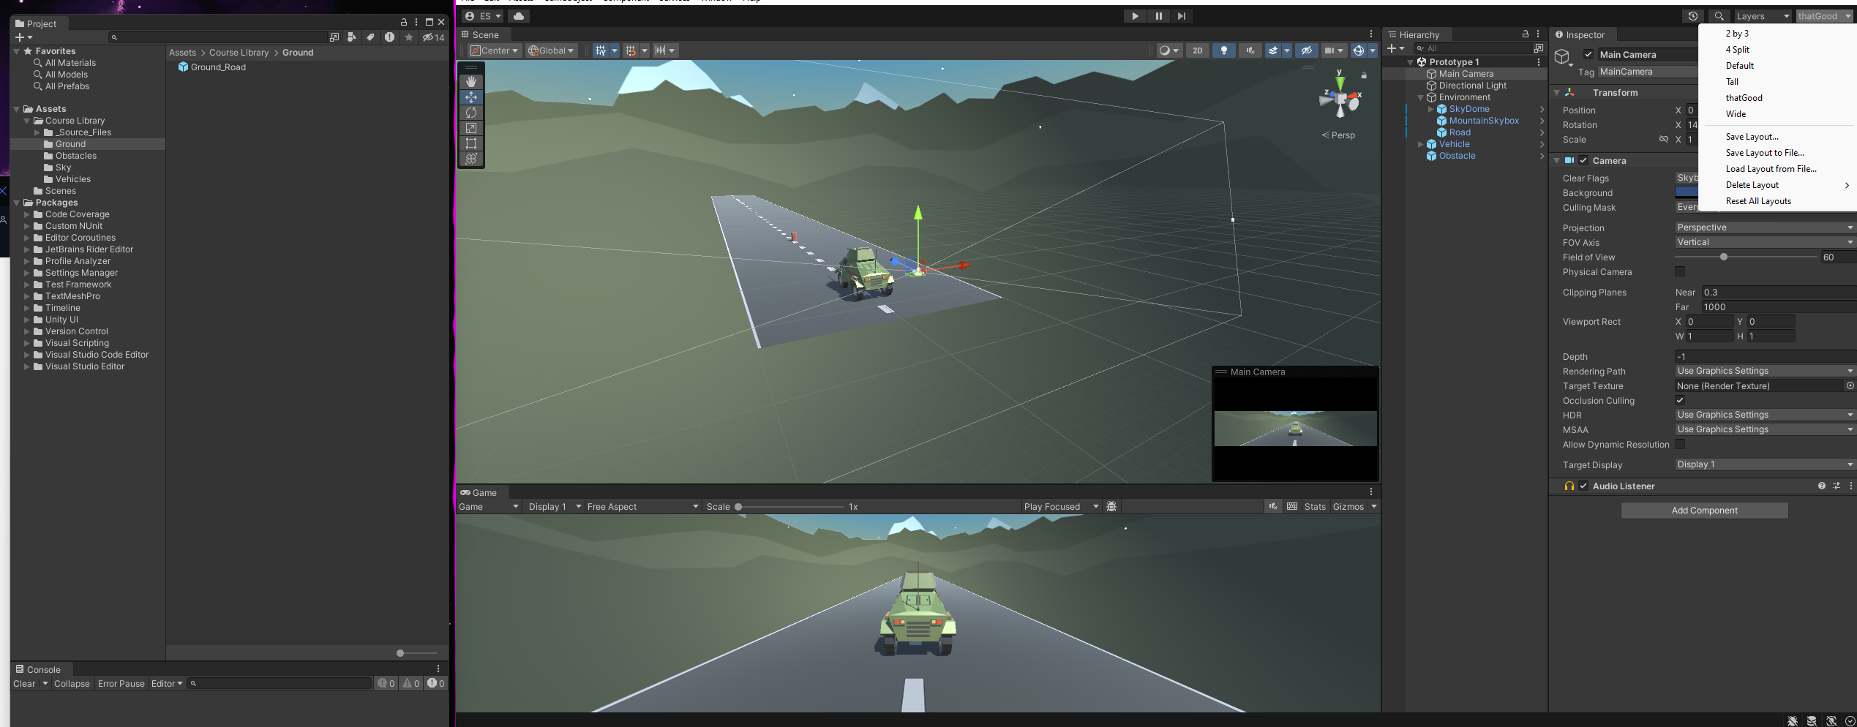
Customize the interface layout
Tutorial
Play with your layout to find a good format for you, it actually helps a lot having a clean setup. I like to even have tabs across multiple monitors.

Slide 14
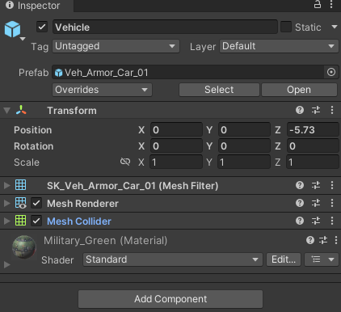
Time to Code
Tutorial
In unity, there’s GameObjects and Components. Components determine how GameObjects behave.
For example, go into play mode, in the scene tab, move the car off the ground and it stays there, we can add or CREATE a component that will make the car be affected by gravity.
We can also, create a component that will… make the car drivable!

Slide 15
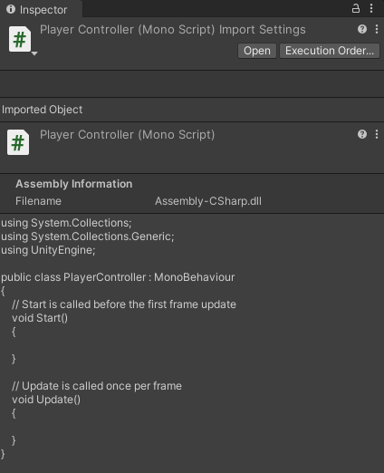
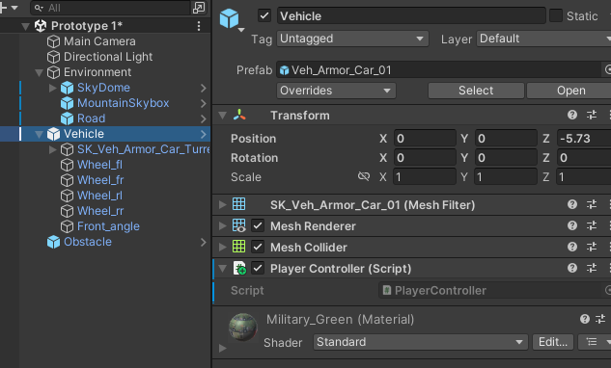
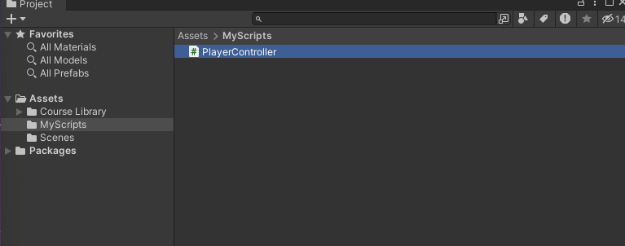
Create and apply your first script
Tutorial
In the Project window, Right-click > Create > Folder named “Scripts”
In the “Scripts” folder, Right-click > Create > C# Script named “PlayerController” *don’t rename your scripts*
Drag the new script onto the Vehicle object
Click on the Vehicle object to make sure it was added as a Component in the Inspector

Slide 16
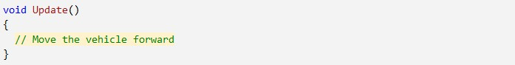
Fire up VS
Tutorial
Double-click on the script to open it in Visual Studio
In the Update() method, add a comment that you will: // Move the vehicle forward

Slide 17
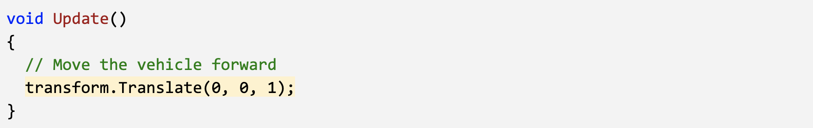
Give vehicle forward motion
Tutorial
Under your new comment, type transform.tr, then select Translate from the autocomplete menu
Type (, add 0, 0, 1 between the parentheses, and complete the line with a semicolon (;)
Press Ctrl/Cmd + S to save your script, then run your game to test it
“transform” refers to the GameObject the component is attached to.

Slide 18
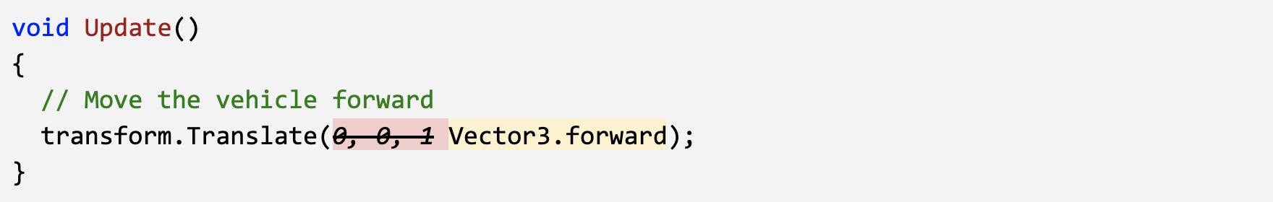
Use Vector3
Tutorial
Easier and more readable. Seems dumb now, but scripts can get messy.

Slide 19
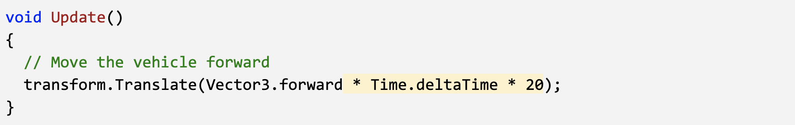
Customize Speed
Tutorial
Add * Time.deltaTime and run your game
Add * 20 and run your game (20 m/s)
Depending on the computer running the game, the car is only going to move relative to whatever fps the computer is allowing
Time.deltaTime: change in time per frame

Slide 20
Add RigidBody components to objects
Tutorial
Select the Vehicle, then in the inspector click Add Component and select RigidBody
Select the Obstacle, then in the inspector click Add Component and select RigidBody
In the RigidBody component properties, increase the mass of the vehicle and obstacle to be about what they would be in kilograms and test again
Now when we collide with the obstacle, the car will get hit.
Notice what happens as you change mass.

Slide 21
Duplicate and position the obstacles
Tutorial
Click and drag your obstacle to the bottom of the list in the hierarchy
Press Ctrl/Cmd+D to duplicate the obstacle and move it down the Z axis
Repeat this a few more times to create more obstacles
After making a few duplicates, select one in the hierarchy and hold ctrl + click to select multiple obstacles, then duplicate those

Slide 22
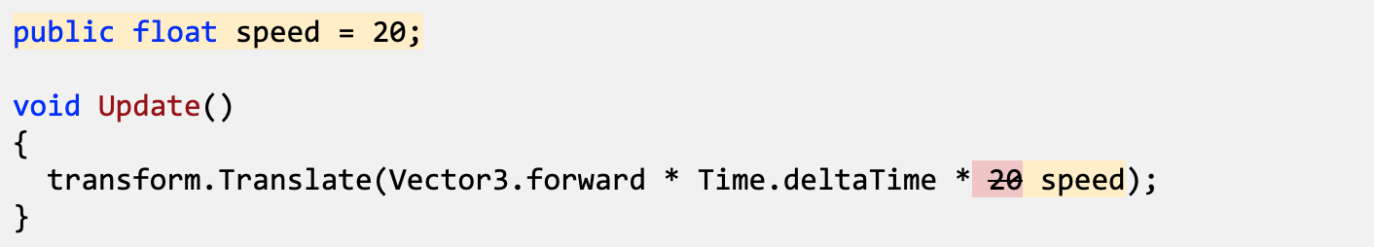
Add a speed variable for your vehicle
Tutorial
In PlayerController.cs, add public float speed = 5.0f; at the top of the class
Replace the speed value in the Translate method with the speed variable, then test
Save the script, then edit the speed value in the inspector to get the speed you want

Slide 23
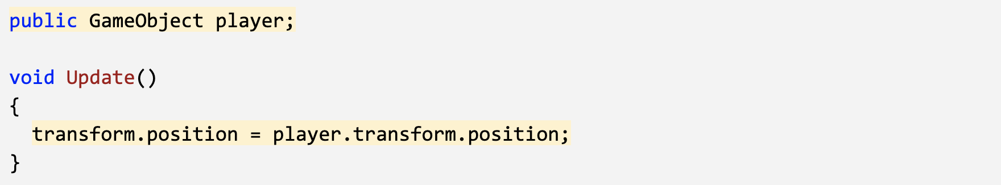
Create a new script for the camera
Tutorial
Create a new C# script called FollowPlayer and attach it to the camera
Add public GameObject player; to the top of the script
Select the Main Camera, then, drag the player object onto the empty player variable in the Inspector
In Update(), assign the camera’s position to the player’s position, then test

Slide 24
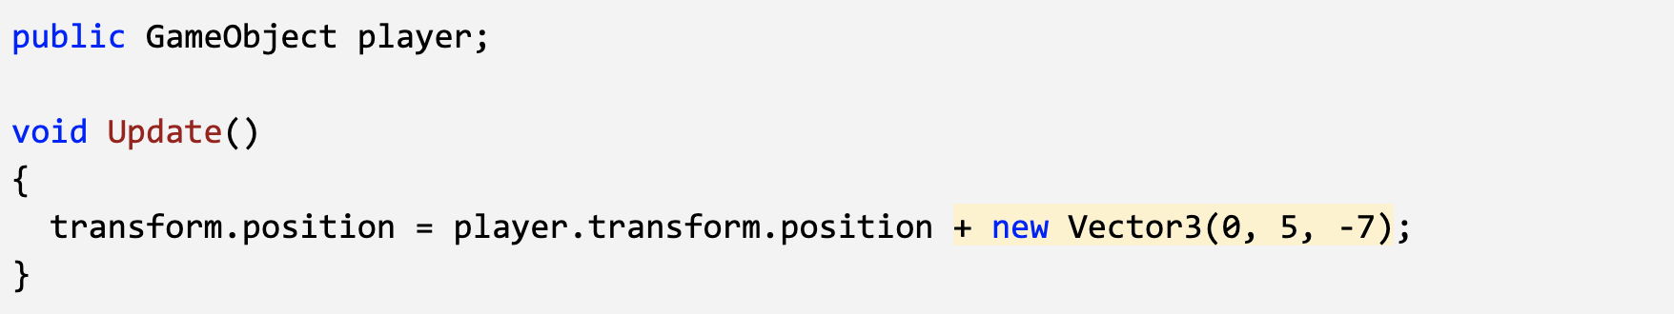
Add an offset to the camera position
Tutorial
In the line in the Update method add + new Vector3(0, 5, -7), then test

Slide 25
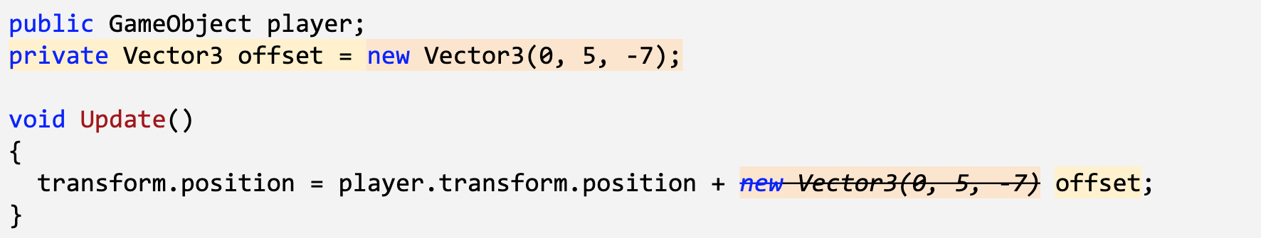
Make the offset into a Vector3 variable
Tutorial
At the top of FollowPlayer.cs, declare private Vector3 offset;
Copy the new Vector3() code and assign it to that variable
Replace the original code with the offset variable
Test and save

Slide 26
Smooth the Camera with LateUpdate
Tutorial
Test your prototype to notice the jittering camera as the vehicle drives.
In FollowPlayer.cs, replace Update() with LateUpdate().
Save and test to see if the camera is less jittery.

Slide 27
Edit the playmode tint color
Tutorial
From the top menu, go to Edit > Preferences (Windows) or Unity > Preferences (Mac)
In the left menu, choose Colors, then edit the “Playmode tint” color to have a slight color
Play your project to test it, then close your preferences
Trust me it’s helpful

Slide 28
Overview of last task
Tutorial
We now need to figure out how to use:
w: forward arrow, positive input value
S: down arrow, positive input value
A: left arrow, negative input value
D: right arrow, positive input value
Speed will multiply the forward arrow pos or neg
Rotation will multiply right arrow pos or neg

Slide 29
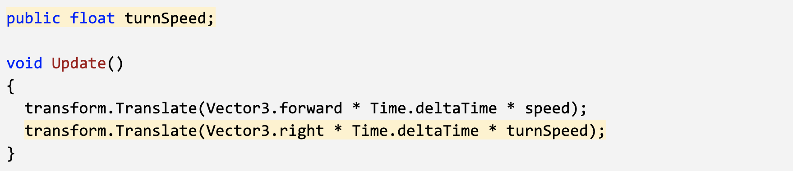
Allow the vehicle to move left/right
Tutorial
At the top of PlayerController.cs, add a public float turnSpeed; variable
In Update(), add transform.Translate(Vector3.right * Time.deltaTime * turnSpeed);
Run your game and use the turnSpeed variable slider to move the vehicle left and right

Slide 30
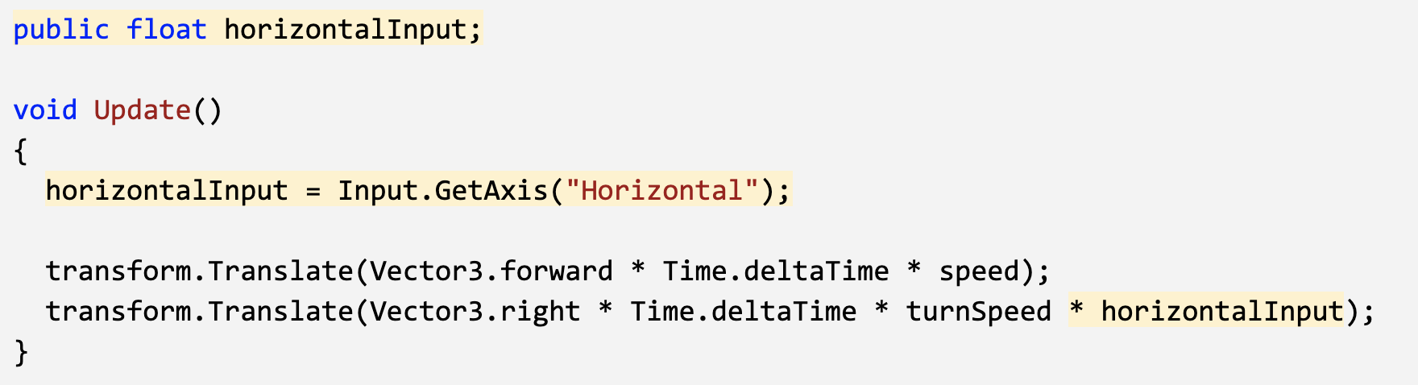
Base left/right movement on input
Tutorial
From the top menu, click Edit > Project Settings, select Input Manager in the left sidebar, then expand the Axes fold-out to explore the inputs
In PlayerController.cs, add a new public float horizontalInput variable
In Update, assign horizontalInput = Input.GetAxis("Horizontal");, then test to see it in inspector
Add the horizontalInput variable to your left/right Translate method to gain control of the vehicle
In the Inspector, edit the turnSpeed and speed variables to tweak

Slide 31
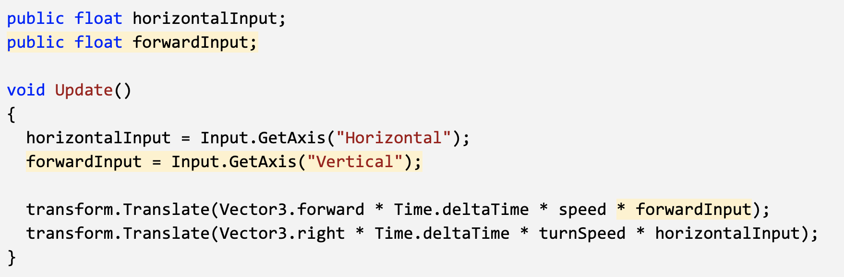
Take control of the vehicle speed
Tutorial
Declare a new public forwardInput variable
In Update, assign forwardInput = Input.GetAxis("Vertical");
Add the forwardInput variable to the forward Translate method, then test

Slide 32
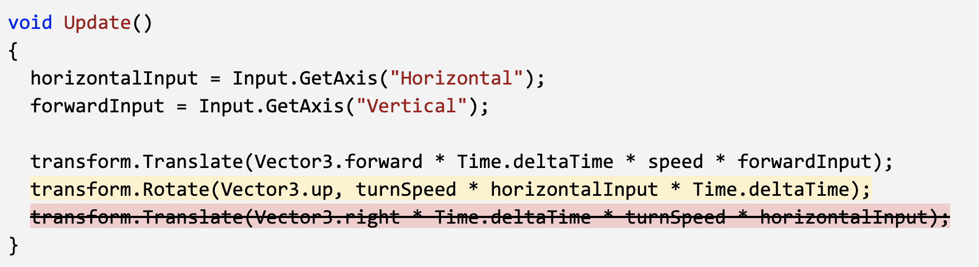
Make vehicle rotate instead of slide
Tutorial
In Update, call transform.Rotate(Vector3.up, horizontalInput), then test
Delete the line of code that translates Right, then test
Add * turnSpeed * Time.deltaTime, then test

Slide 33
COPY
Tutorial
If

Slide 34
COPY
Tutorial
If

